Slide 1

Tourism and hospitality management system

Slide 2

What is a Tourism and Hospitality Management System?
A Tourism and Hospitality Management System is a comprehensive software solution designed to streamline and enhance the operations of businesses in the tourism and hospitality industry. It encompasses modules for reservations, bookings, guest management, billing, and other essential functions, facilitating efficient day-to-day operations. The system also often includes features such as inventory management, reporting, and analytics to help businesses optimize their resources and improve customer experiences. By centralizing tasks and information, it enables businesses, including hotels, resorts, and travel agencies, to manage their services more effectively, enhance customer satisfaction, and ultimately drive overall operational efficiency in the tourism and hospitality sector.

Slide 3
What should the Application contain?
A Tourism and Hospitality Management System web application should include features such as online reservation and booking functionality, user-friendly interfaces for guests and staff, real-time availability updates, secure payment processing, customer relationship management (CRM) tools, and reporting modules for analytics. Additionally, it should support room and resource management, automated communication systems, and integration with third-party services like maps and review platforms. Mobile responsiveness, multilingual support, and robust security measures are essential for a comprehensive solution. Efficient inventory management, staff scheduling, and guest feedback mechanisms further enhance the system's effectiveness, providing a seamless experience for both customers and hospitality providers.

Slide 4

Statistics from Public Feedback
The public feedback for our Tourism and Hospitality Management System web application has been overwhelmingly positive. Users appreciate its intuitive interface, which streamlines booking processes and enhances overall user experience. The real-time updates on travel itineraries and personalized recommendations have garnered praise for their efficiency. Additionally, the responsive customer support has earned high marks, resolving queries promptly. Some users have suggested minor improvements in the search functionality, indicating a desire for enhanced customization options. Overall, the feedback reflects a strong satisfaction with the application's functionality and highlights its potential for further growth through continuous refinement based on user input.

Slide 5
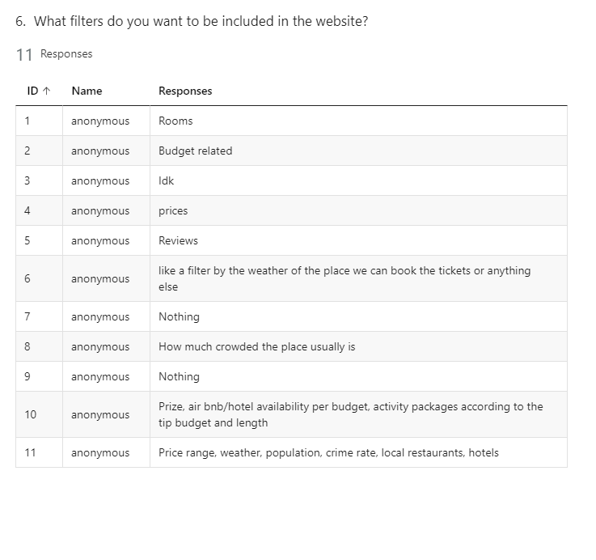
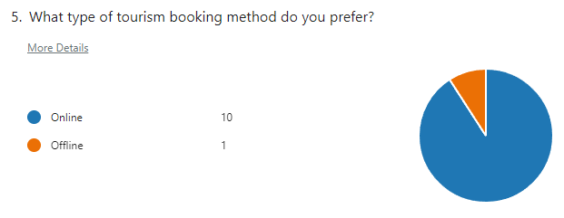
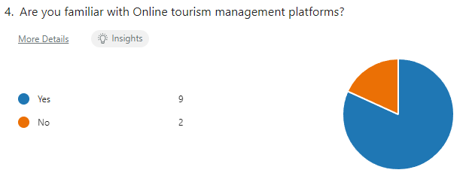

Slide 6

What Customers Desire From a Tourism Website
Reduce and Eliminate Expenses
Decide on a Location
Set Goals and Create a Plan

Slide 7

Proposed Solution
Our strategy for the THMS Web Application involves an integrated approach to technology and user-centric design. The user interface will be intuitive, providing easy navigation for travel planning, accommodation bookings, and activity reservations. The AR-powered exploration feature will guide users through destinations, while the sustainable travel planner will promote eco-friendly choices. The blockchain-based loyalty program will ensure secure and transparent transactions, fostering customer trust. Rigorous testing will guarantee seamless functionality, cross-device compatibility, and optimal performance for users seeking diverse travel experiences.

Slide 8
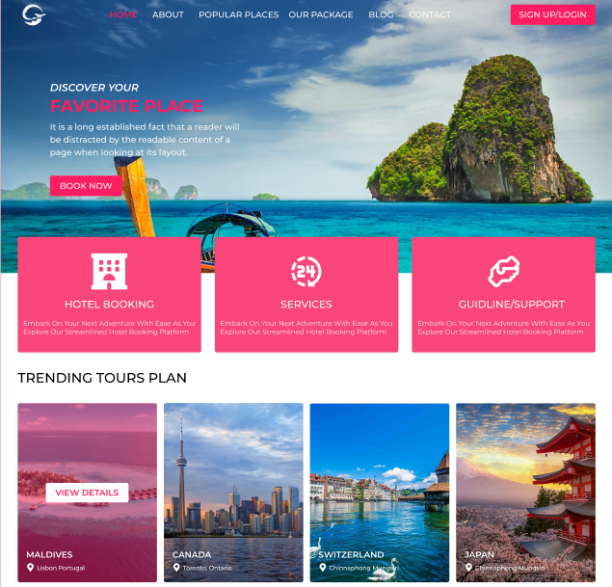
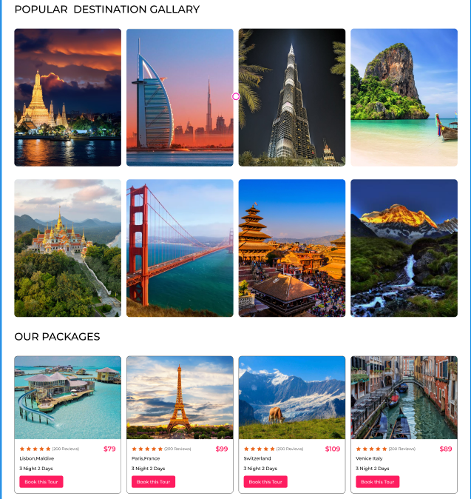
Prototype using Figma

Slide 9
Why Our Application is unique from those existing now
Sustainable Travel Planner: Develop a feature that calculates and promotes eco-friendly travel itineraries, suggesting low-impact transportation, eco-certified accommodations, and activities to encourage responsible tourism.
Personalized Cultural Immersion: Implement an AI-driven system that tailors travel recommendations based on users' cultural preferences, learning styles, and interests, ensuring a more personalized and enriching travel experience.
Blockchain-backed Loyalty Program: Introduce a decentralized loyalty program using blockchain, enhancing transparency, security, and ease of redemption for loyal customers across various travel and hospitality services.
Universal Language Translation: Integrate advanced real-time language translation capabilities to facilitate seamless communication between tourists and locals, fostering a more immersive and inclusive travel experience.

Slide 10

Thank you
M.Rohit-2200033118
K.Vishnu-2200090229
Ch.Nithin-2200031947

